Slide 1
Jak působí gadolinium na DTI
Amír Zolal
Martin Sameš
Martina Nováková
Milouš Derner

Slide 2
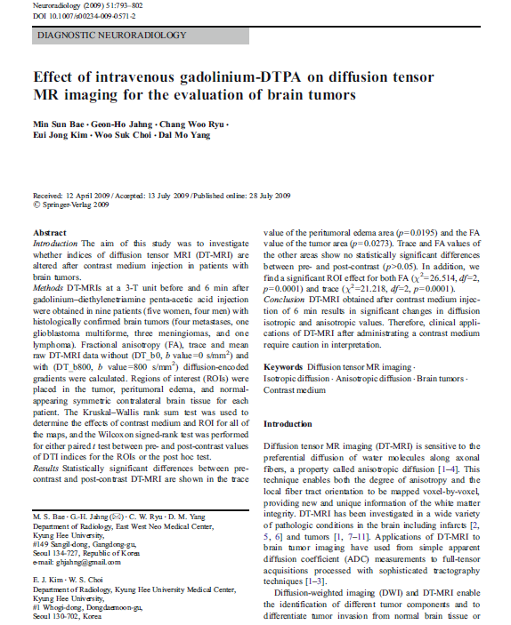
Důvod, proč to zkoumat

Slide 3
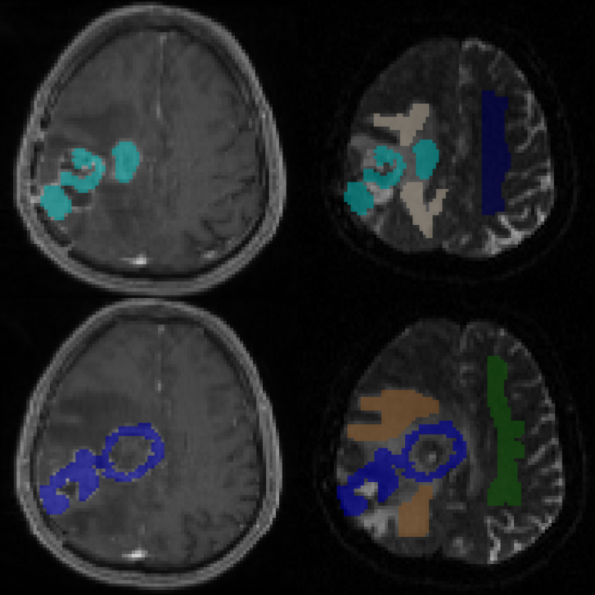
Metody - ROI

Slide 4
METODY
16 pacientů, 5 ROI v každé oblasti u každého
DTI Studio v. 3.0.2 (https://www.mristudio.org/)

Slide 5
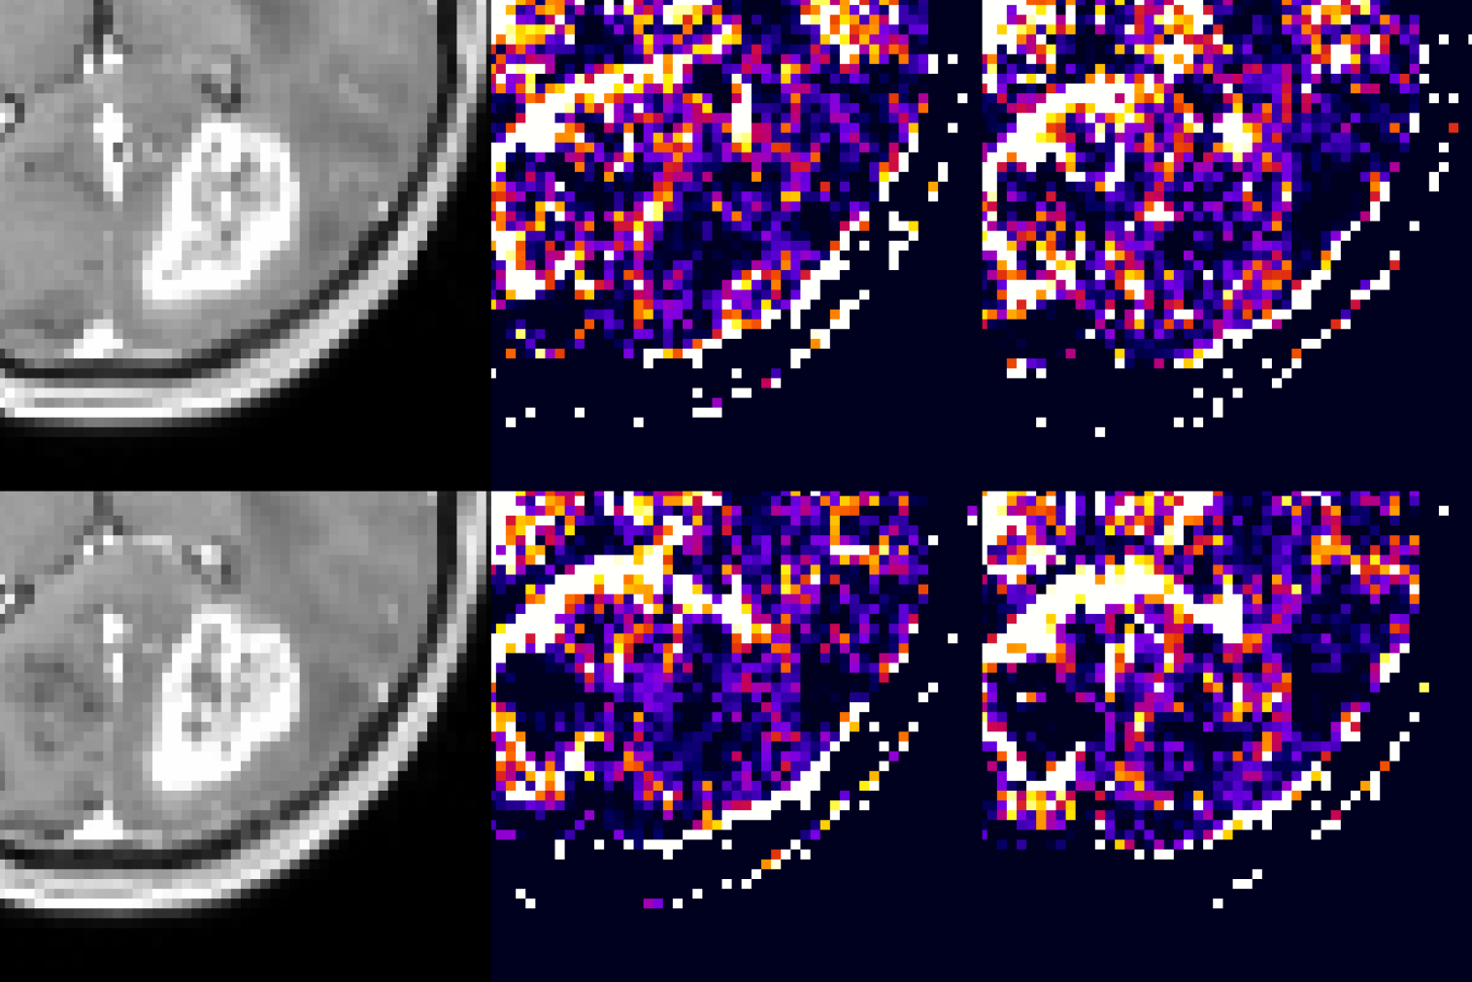
Výsledek

Slide 6
Výsledky - překvapivé
Fractional anisotropy
We have found a significant increase of FA in the contrast enhancing areas in the post-contrast scans, when compared to the corresponding ROI averages in the pre-contrast scans. The median increase for the contrast enhancing ROIs was 0.023 compared to the pre-contrast scans, with a p-value on the order of 1e-11. Moreover, we have found a rather small, yet significant difference between the pre- and post-contrast averages in the corresponding ROIs in the peritumoral edema (median difference = 0.005; p ≈ 1e-4). The difference for the NAWM ROIs was just marginally insignificant (median difference = 0.005; p > 0.01). Using the Mann-Whitney U test, we have also compared the contrast-induced changes among the three areas we investigated and found a highly significant difference between the changes observed in the CE and PE areas (p ≈ 1e-8) and the CE and NAWM areas (p ≈ 1e-10). There was no significant difference between the changes in the PE and NAWM areas (p ≈ 0.6). Pearson’s correlation coefficients between the matching pairs of averages were above 0.85 and highly significant (p < 1e-3) for all examined regions.

Slide 7
Výsledky – částečné vysvětlení
We have also used the Wilcoxon paired samples test to compare the contrast-induced changes in the three eigenvalues. For this comparison, the contrast-induced change index was computed as a percentage of the pre-contrast value (change = 100*(pre-contrast – post-contrast)/pre-contrast). For the CE regions, we have observed the largest decrease in the third eigenvalue, with a median decrease of 5.8%, followed by the second eigenvalue with a 3.3% median decrease and the first eigenvalue with a 2.5% median change. The paired samples Wilcoxon test was highly significant (p<1e-8) in multiple comparisons for the differences between the three change indices. In the PE regions, the observed contrast-induced changes were smaller with median percent changes of 0.7%, 1.1% and 1.6% for the first, second and third eigenvalues, respectively. The Wilcoxon test was significant on the order of 1e-3 to 1e-4 for multiple comparisons among these indices. For the NAWM, the observed contrast-induced changes were not significantly different between the three eigenvalues.

Slide 8
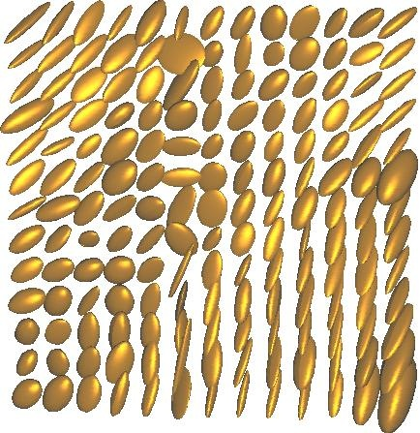
DTI tenzory

Slide 9
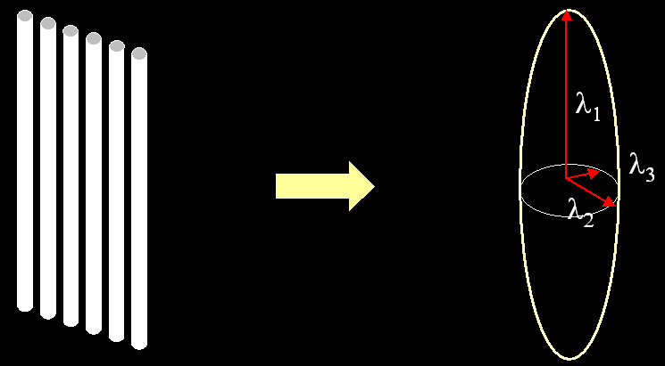
Vlastní číslo (eigenvalue)

Slide 10
Vliv Gd-kontrastu na DWI
Previously, there have also been contradictory results published regarding the effect of gadolinium-based contrast agents on diffusion-weighted imaging (DWI). While some have found no effect of the contrast medium on the results [10], some have reported statistically significant changes in the ADC [11]. Firat et al. [12] have also suggested that the effect on the ADC might be diminishing with time from the contrast media application. Unlike the original study of Bae et al. [3], both studies [11; 12] that have detected changes after contrast agent administration also detected statistically significant changes in normal white matter.

Slide 11
Bae 2011
Fractional anisotropy
Normal
  0.37 ± 0.04 - 0.38 ± 0.03
Tumour
  0.18 ± 0.09 - 0.20 ± 0.07

Slide 12
Výsledek - praktický
Udělali DTI sken po podání kontrastu? pokud jde o trasování před operací, nic hrozného se neděje
ALE ty snímky jsou samozřejmě nepoužitelné pro studie
tedy nemělo by se to dělat rutinně

Slide 13
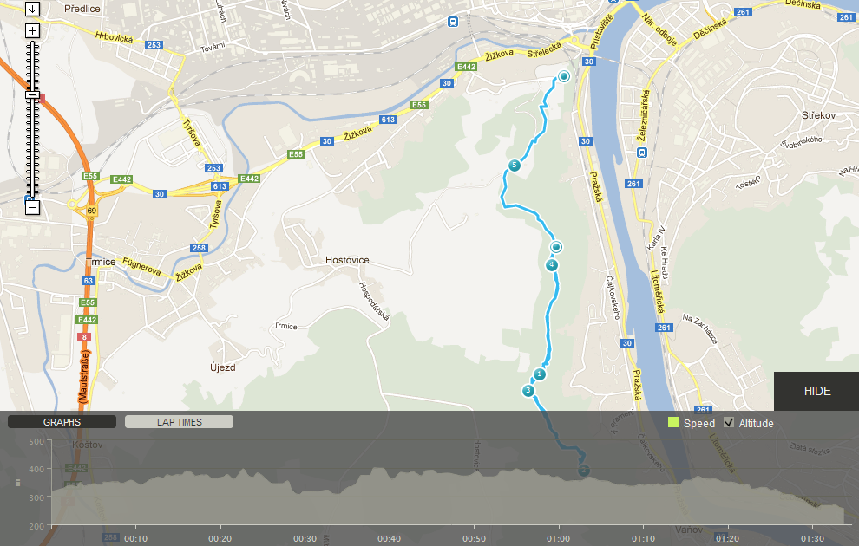

Slide 14
